Slide 1

GET YOUR PERFECT FIT/ BEST OUT OF STOCK
Group-6:
Harsimran Kaur (016003468)
Mounica Ayalasomayajula (015969759)
Saumya Sinha (016040674)
Karnik Ketan Kalani (016038282)
Vidushi Bhati (015309736)
DATA-225 SEC 11 - DB SYSTEMS FOR ANALYTICS

Slide 2
OVERVIEW
The Main idea behind his project is to predict the best outfits for the specific customer based on their body shape,size, colour preferences,fabric material and choosing cloth depending on various skin issues.
Aim of this project is to understand and create a recommendations based on evaluating all the factors that a customer would like to consider before placing an order.

Slide 3
Business Objectives
Allow customers to filter products on different factors such as size, color, product types, body measurement, body shape and fabric type.
Allow customers to figure out their body shape depending on their body measurements .
Allow user to select fabric according to their skin conditions .
Analysing the demand from customers in order to maximize the product's stocks focusing on bringing current fashion to the customers.

Slide 4
Technology used
Database – MySQL,MongoDB
ETL tool – Python, MS-Excel, AWS Glue
Data warehouse – AWS Redshift, S3 bucket
Data Modeling Techniques – Entity-Relationship data modeling
Data Visualization – Tableau
Code Standard – Python, SQL
Version Control – Github
Practiced agile / scrum – JIRA
DB Connectivity – Python to MySql

Slide 5
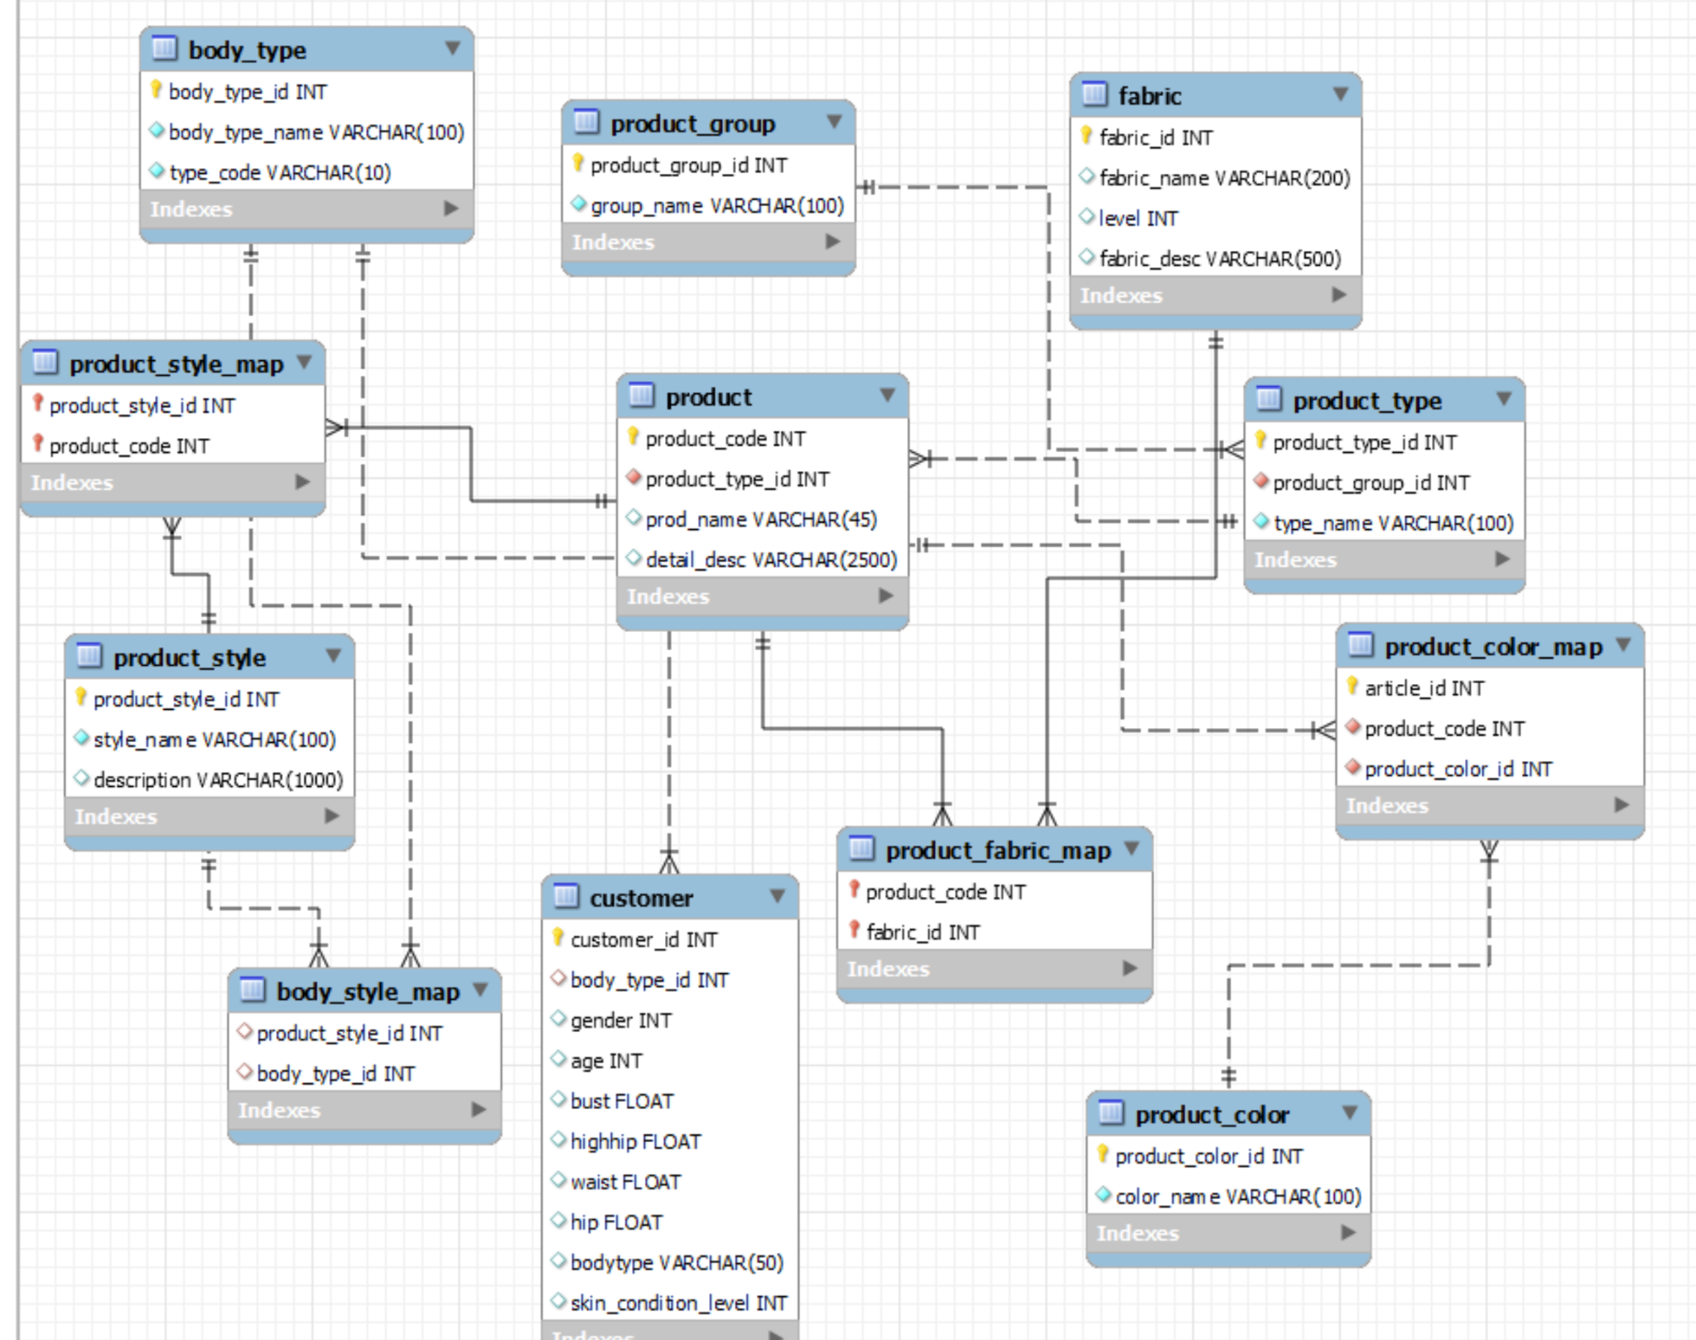
DATABASE DESIGN-ER DIAGRAM

Slide 6
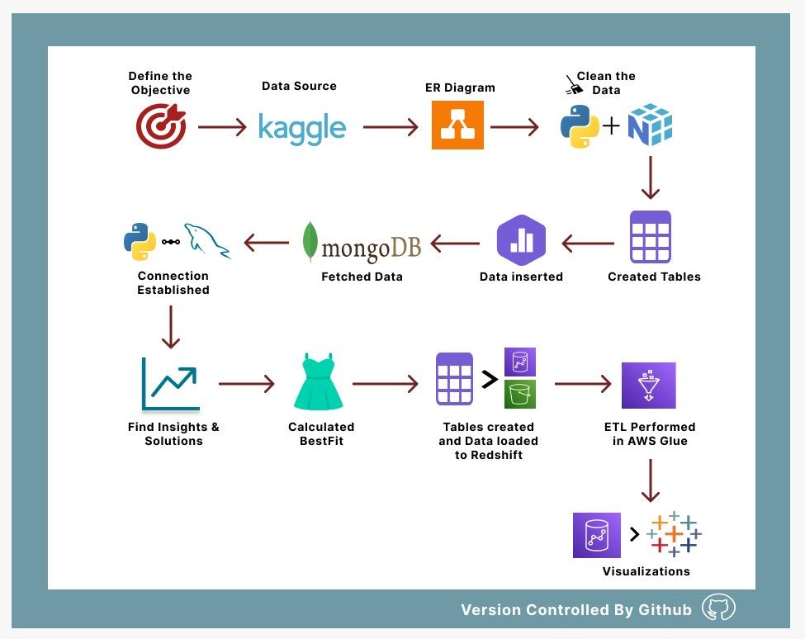
WORKFLOW

Slide 7
Demo

Slide 8
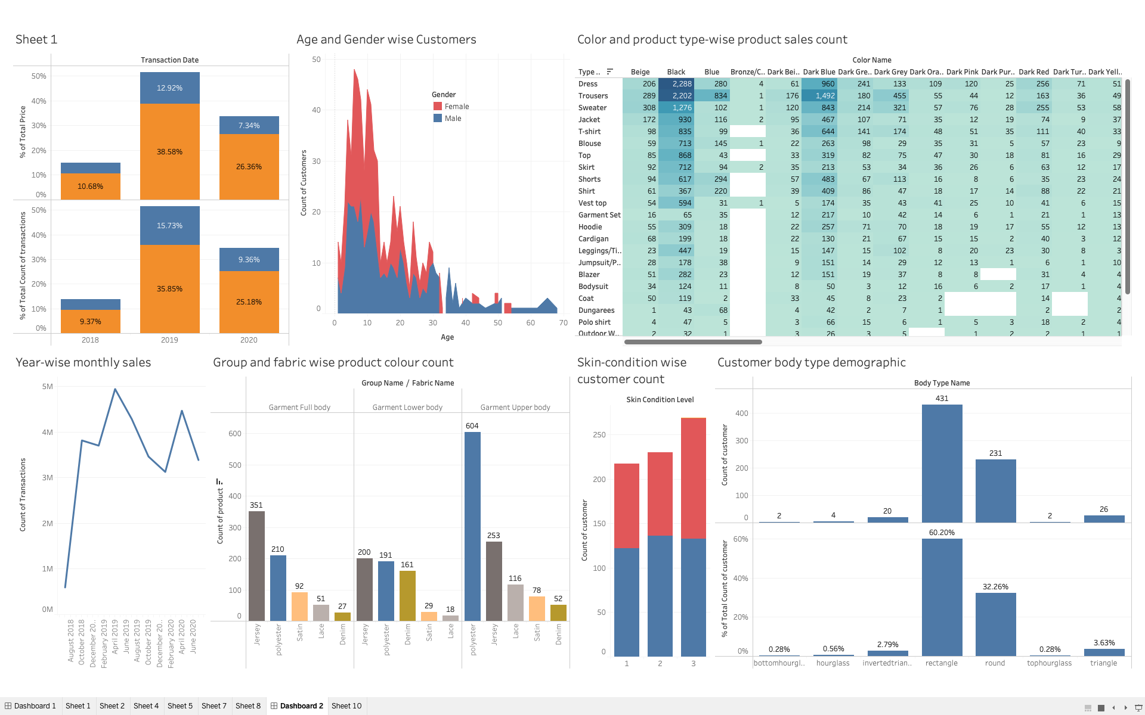
Visualization

Slide 9
Key Learnings
Using the python connectivity with the MySQL server for generating functions and querying to determine individual’s body type and providing them with their desired product choices along with informing them regarding the fabric of the product and what all skin conditions is it suitable for..
Data cleaning in jupyter notebook using python.
Using MongoDB for fetching the body measurement configuration and input customer id and skin condition level.
Using AWS cloud services such as AWS Redshift for data warehousing, AWS S3 for data storage, AWS Glue for our ETL process.
Connecting AWS Redshift with Tableau for visualizing our results.

Slide 10
Technical Difficulties
Not enough trained data in H&M dataset as per our objective, so we created synthetic data for the following categories:
Fabric
Skin conditions
Customers
Thus linking our synthetic data with the available data such as products was challenging.
Transaction data was very large(3GB) and it was taking more than 10 hrs to load that data in MySQL workbench. Therefore, we used that table using the AWS Redshift query editor.

Slide 11
CONCLUSION
This project covers all the basic features of any online shopping website.
This project is to help the customers by showing only those products which are meant for and are required by the customers based on their skin conditions and body type.
Filters provided to the customers give easy accessibility to get desired product along with fabric information.
Fulfilled our objective of learning RDBMS,Data warehouse, MySQL, ETL processes and implementing queries to create useful information and present them with the use of Data Visualization techniques.

Slide 12
FUTURE WORK
We can further implement some features like-
Find solutions for analysing needs for efficient amount of supplies according to customer’s demand and thus, minimizing the excessive unnecessary product stocks.
Once enough data is gathered for the customers, the system can be evolved by using machine learning techniques that can be applied to recommend options based on body shapes and sizes.
The background about the customer’s choice of styles and what majority of age group people like to wear could also be determined.
Better inferences by using other advanced tools and techniques.
Alert emails or notifications once the desired product is in stock.

Slide 13
QUESTIONS AND ANSWERS?
THANK YOU!!

